Slide 1

CITIBIKE: UNDERSTANDING RIDERSHIP PATTERNS
DAV 6100 – SECTION 1 – GROUP 2
Surya Suresh Sriraman | Sukumar Chigurupati | Pavankalyan Padala | Saivarun Atmakuri

Slide 2


INTRODUCTION
This project dives into NYC's December 2023 Citi Bike ridership data, incorporating weather insights to optimize the program. By analyzing how weather affects ridership patterns, we aim to improve bike availability, target marketing efforts, and inform sustainable city planning initiatives.
Problem: Optimizing NYC's Citi Bike program requires a deep understanding of ridership patterns and their influencing factors. Traditional methods lack the ability to integrate weather data, leading to missed opportunities for targeted service improvements.
Solution: This project leverages December 2023 Citi Bike trip data and a weather API to create a comprehensive data model. By merging and transforming the data into a star schema, we can analyze ridership trends alongside weather conditions.

Slide 3


USE CASE
Optimizing Bike Availability: Understanding ridership patterns based on weather allows for strategic bike rebalancing to meet demand.
Targeted Marketing Campaigns: Identifying favorable weather conditions can inform marketing efforts to encourage ridership during peak periods.
Sustainable City Planning: Insights can guide city planning decisions to promote cycling as a viable and environmentally friendly transportation option.

Slide 4

ABOUT DATA
 | Citibike Trip Data | NYC Weather Data
Level of Data | Rides | Hourly
Duration | December 2023 | December 2023
Number of Records | 24,491 | 744
Number of Fields | 13 | 24
Filetype | CSV | JSON
Extraction Method | Downloadable Files | API Call
Subset | Central Park West | NYC

Slide 5
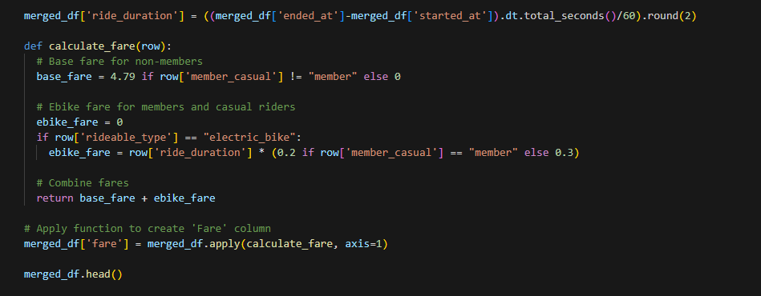

DATA PREPARATION
Citibike
Weather
Day & Hour

Slide 6
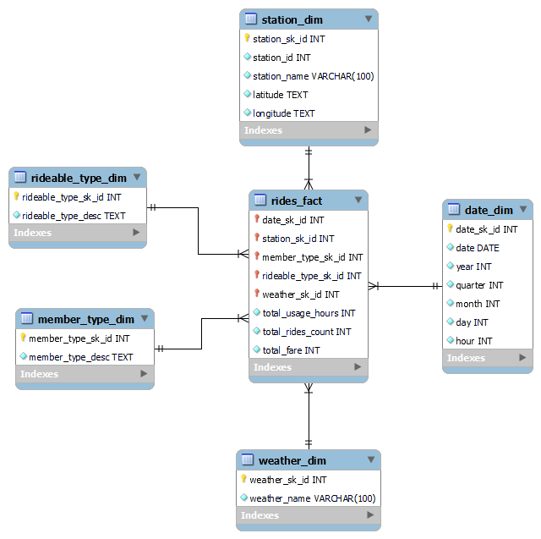
DATA MODEL
Schema: Star Schema
Dimension Tables:
Station
Date
Weather
Member Type
Rideable Type
Fact:
Details about
usage_hours,
number_of_rides,
total_fare
at hour level

Slide 7
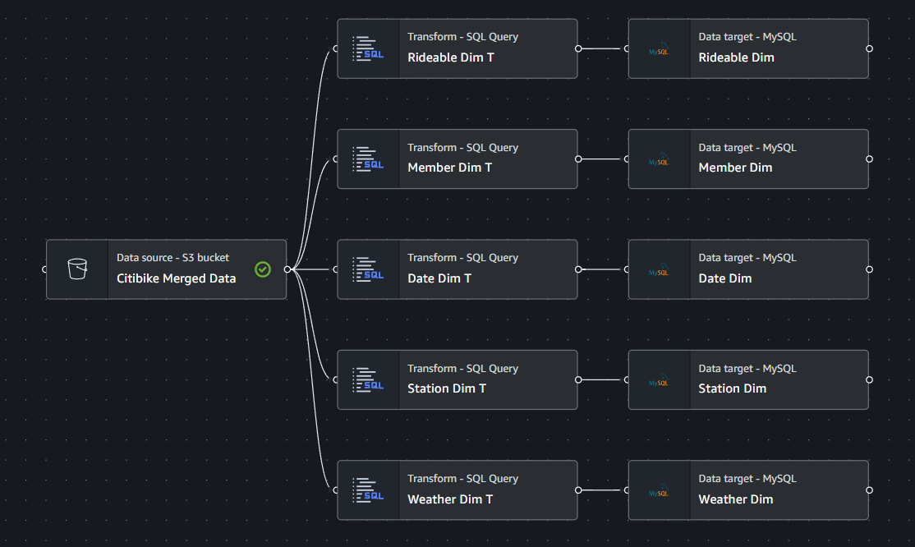
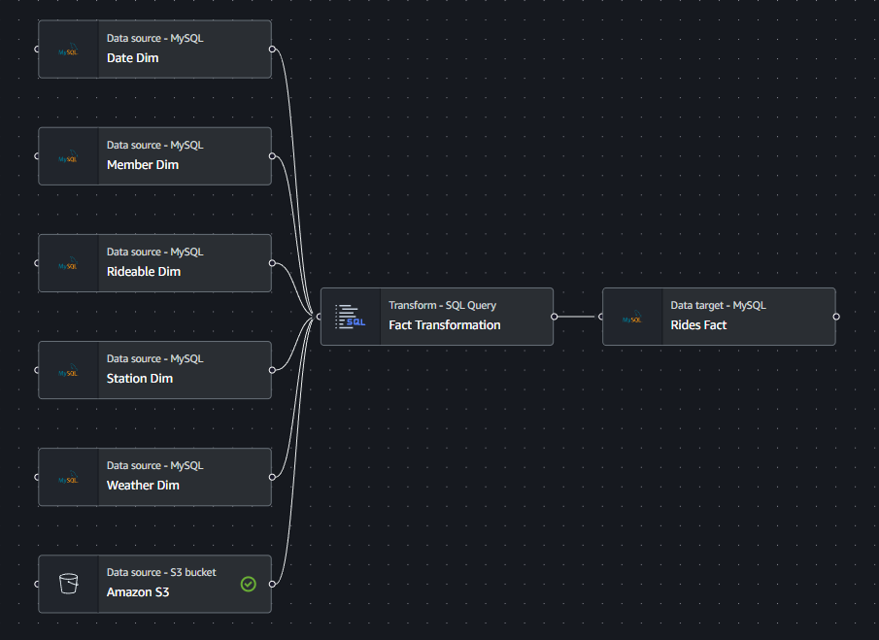
EXTRACT TRANSFORM LOAD PROCESS
Dimensions
Fact

Slide 8
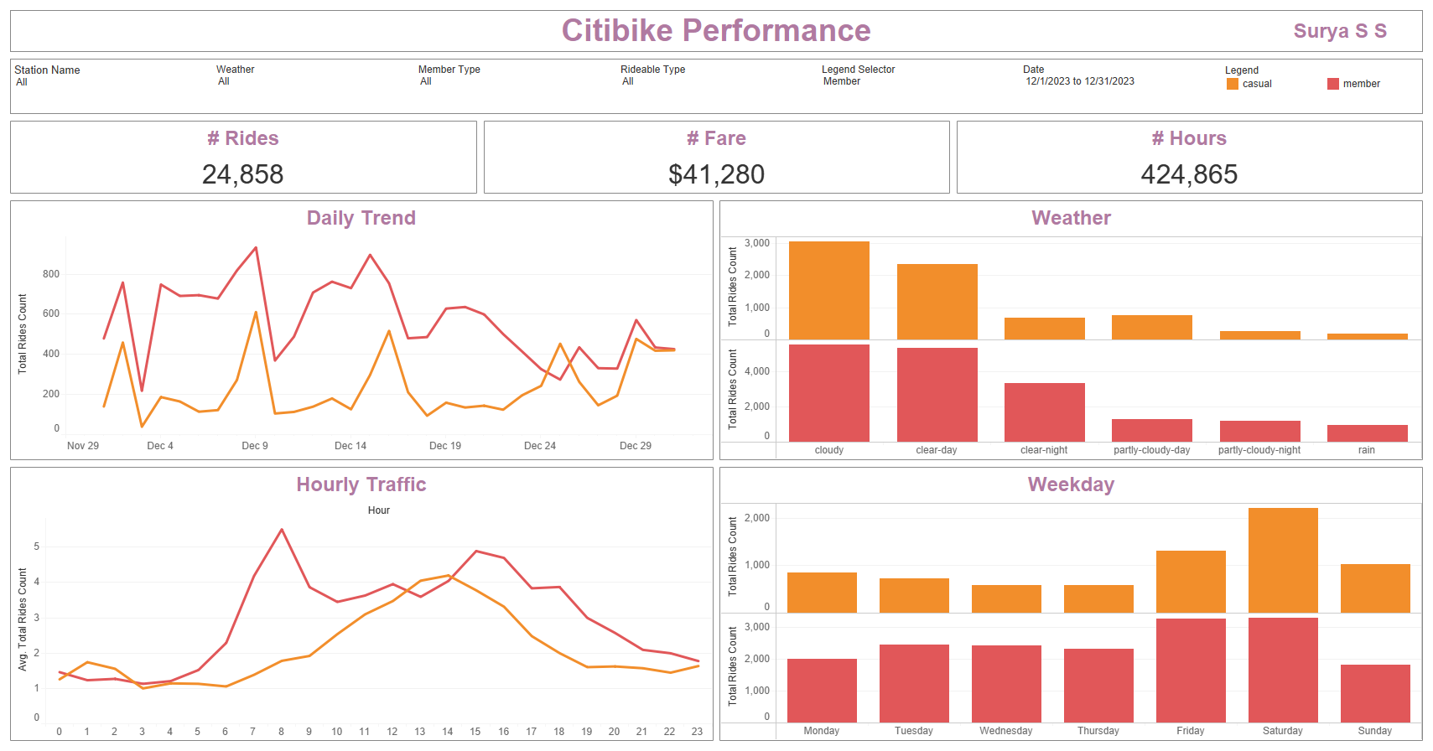
VISUALIZATION

Slide 9
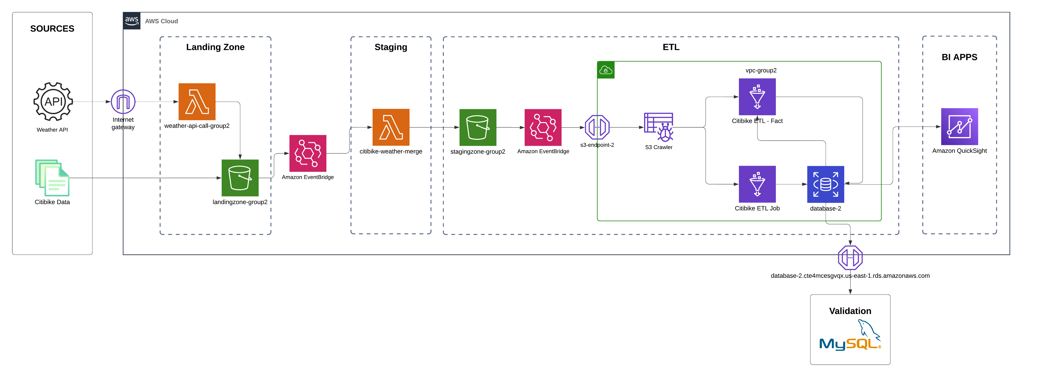
AWS ARCHITECTURE

Slide 10
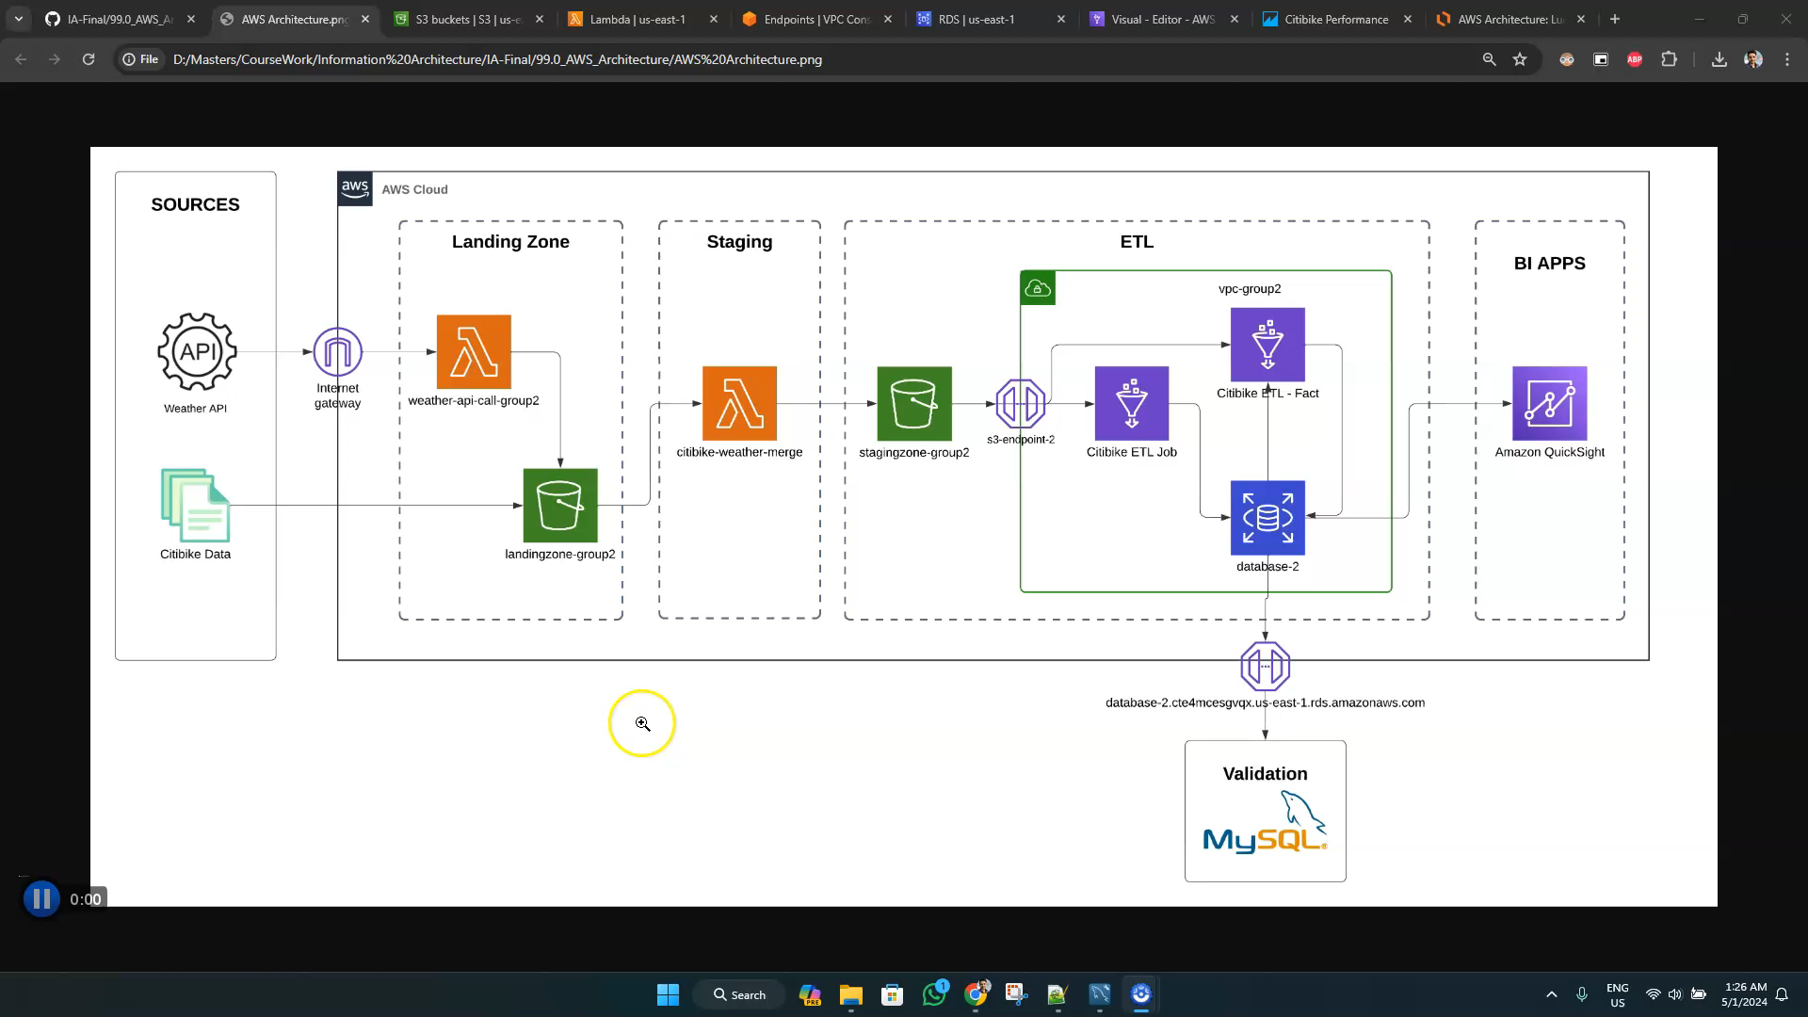
AWS DEMO

Slide 11
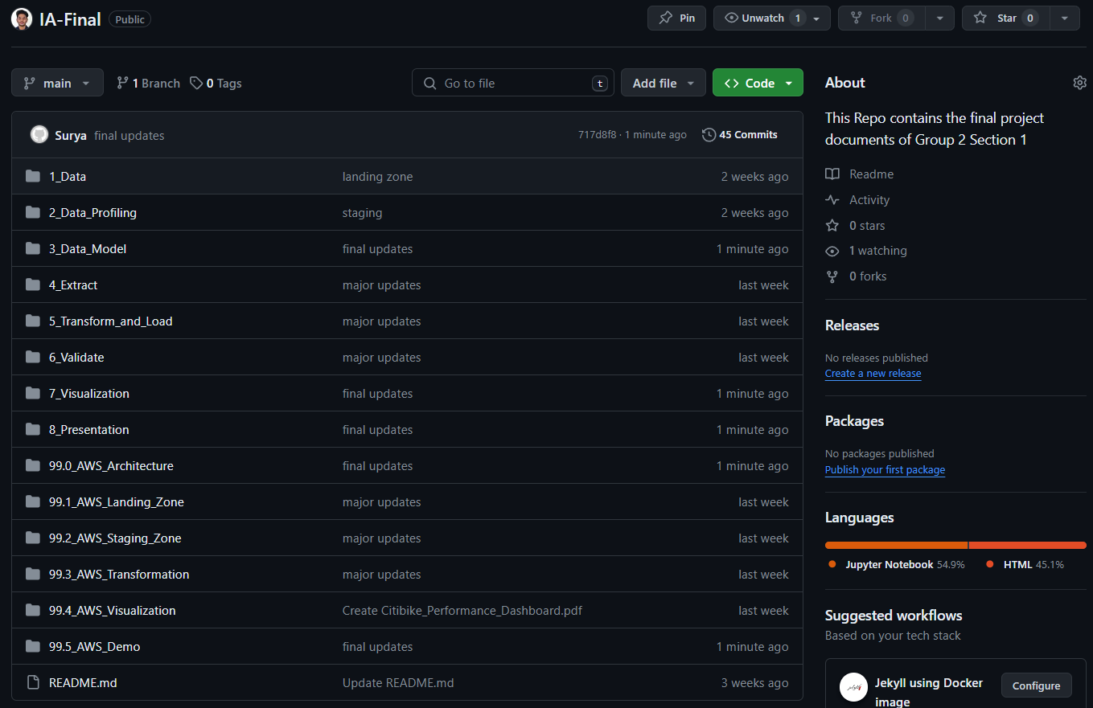
DOCUMENTATION
https://github.com/s-surya-s/IA-Final

Slide 12

CONCLUSION
We have successfully developed a Star Schema Datawarehouse solution. By leveraging this data warehouse, we have created visualizations that can help in analyzing the December 2023 Citi Bike ridership data alongside weather information. These valuable insights can be used for optimizing bike availability, targeting marketing efforts, and informing sustainable city planning.
Challenges:
Implementing ETL using Glue
Lessons learned and improvement:
Increase the level of subset
Analyze other factors that could affect ridership like holidays etc.

Slide 13
THANK YOU

